Slide 1
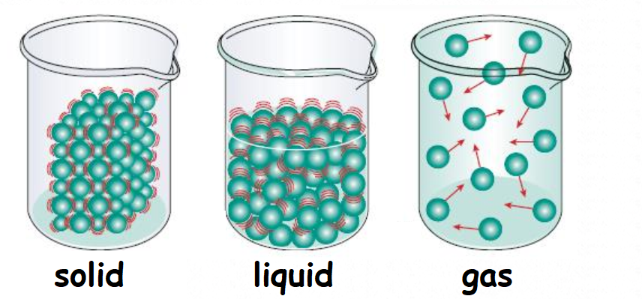
Particle Theory of Matter
An Introduction to Chemistry

Slide 2

Minds On
Rip a piece of paper in half
Keep ripping it into smaller and smaller pieces
Can you keep on ripping it forever?
The ancient Philosophers thought about this simple question for all the different types of matter (stuff) on Earth.

Slide 3
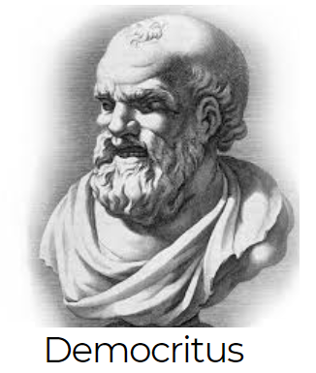
What Is Matter?
The Ancient Philosophers knew…
Matter has ______
Matter takes up _______
mass
space
They used logic to hypothesize that…
All matter is made up of microscopic ________
Each pure substance has its own _________ type of particle
If you split these smallest particles then you would end up with something ________
particle
unique
different

Slide 4
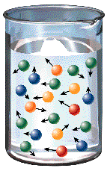
Today We Know:
right
The Ancient Philosophers were _________!
All matter is made up of microscopic particles
Each pure substance has its own
unique type of particle
We also know that:
The particles are always ________
Particles move ________in a solid. (e.g. Ice)
Particles move more ________in a liquid or gas. (e.g. Water or steam)
Temperature is a measure of how fast particles are moving!
moving
slowly
quickly

Slide 5
The Particle Theory of Matter
tiny
All matter is made of extremely ______ particles
All pure substances are made of their own _______ of particle
All particles are _______________.
Particles at higher temperatures move _________ than those at lower temperatures.
Particles are ___________ to each other.
kind
moving
faster
attracted

Slide 6
Three States of Matter
For normal conditions, there are three states:
Solid – Particles are ______ together
Liquid – Particles are ________ apart
Gas – Particles are _______ far apart
close
farther
very
The particles are the same in each state!
They just have a different ___________
And they are moving ___________
temperature
differently

Slide 7
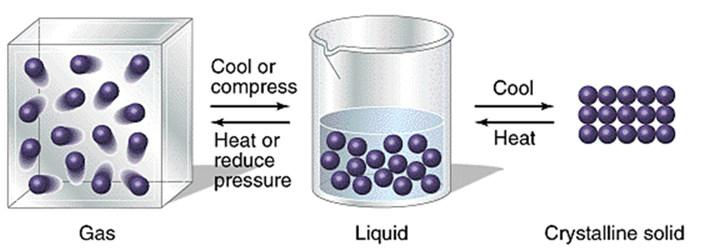
Water
Particles are moving slowly.
Particles are ________ spaced and strongly attracted
Ice
Water particles are moving very slowly
Particles are _______ in place and are very strongly attracted
Water Vapour
Particles are moving ______
Particles are _______ apart and weakly attracted
fast
far
closely
locked

Slide 8
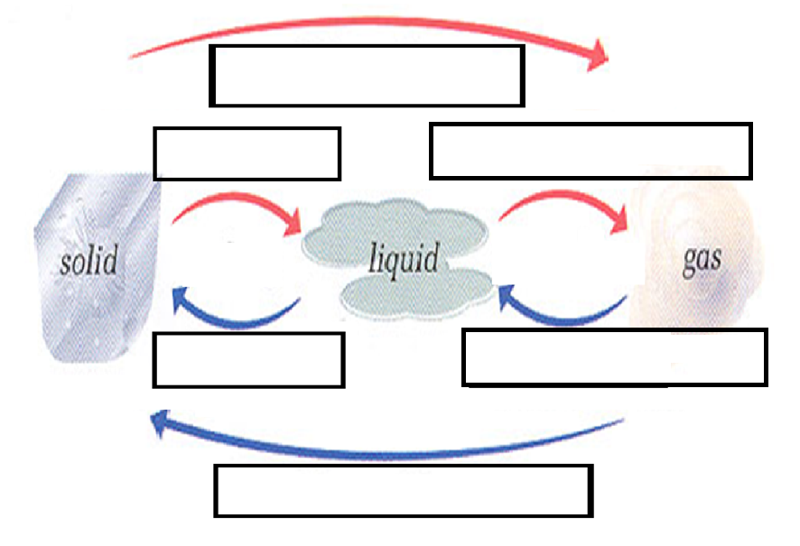
Changes of State
sublimation
melting
evaporation
freezing
condensation
deposition

